Slide 1
BCPR282 – Assignment 2
Wesley Wichman

Slide 2
Must Features
Button for loading a level
Button for saving a level
Swipe–handling to move Theseus up
Swipe–handling to move Theseus down
Swipe–handling to move Theseus left
Swipe–handling to move Theseus right
Double-tap to pause
Display image as Theseus
Display image as Minotaur
Draw a Maze
Auto generating a maze based on level data
Display a maze
Draw the walls
Dialogue if Minotaur kills Theseus
Dialogue if Theseus wins/escapes
Display move counts in a textbox
Display dialogue with options after Theseus has been killed
Display dialogue with options after Theseus exists successfully
Play a happy noise after Theseus exits successfully
Play a sad noise after Theseus has been killed

Slide 3
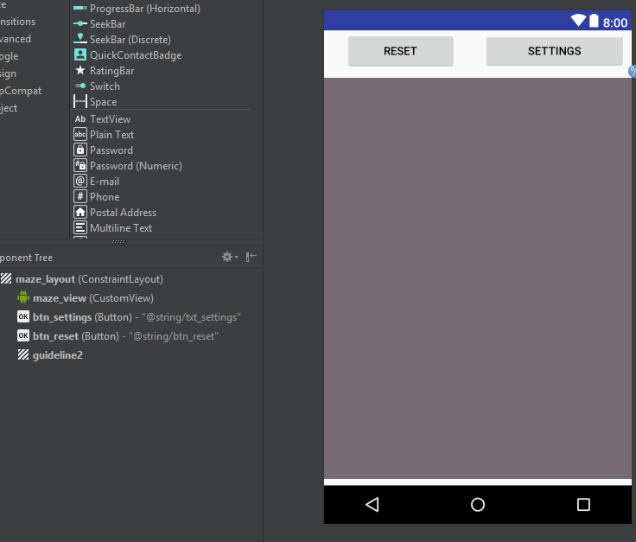
Custom View
My “custom view” involves extending the functionality of the imageView object created in Android. This allows the activity to contain the base layout and pass all the logic to the custom view item e.g. setTheseus(theseus) will take the theseus point object and the will draw it in the correct position

Slide 4
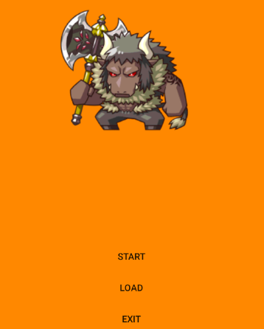
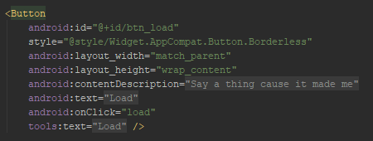
Custom View
1. Button for loading a level

Slide 5
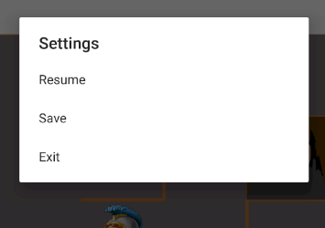
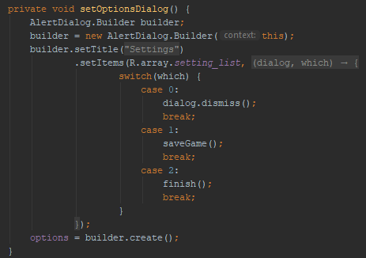
Custom View
2. Button for saving a level

Slide 6
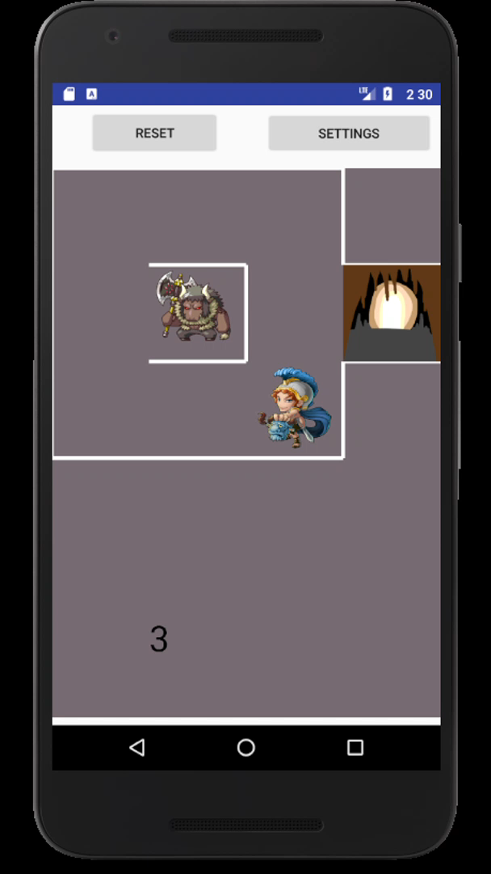
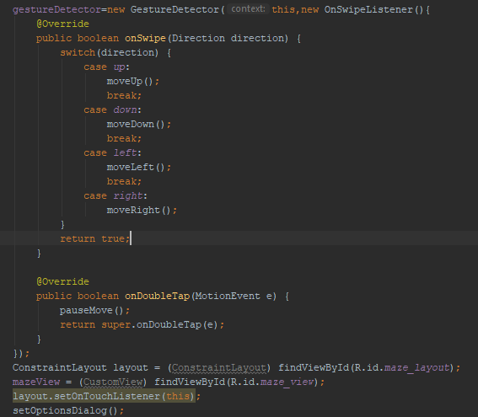
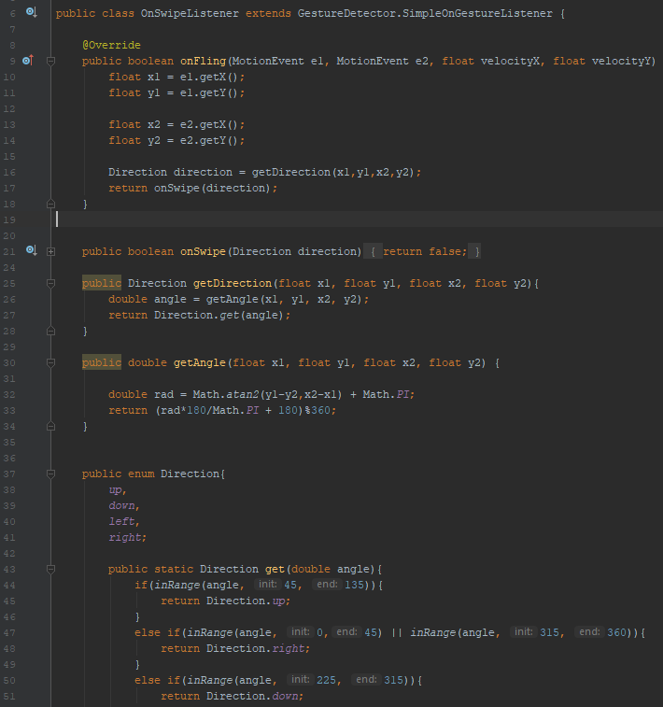
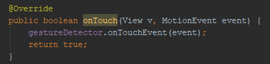
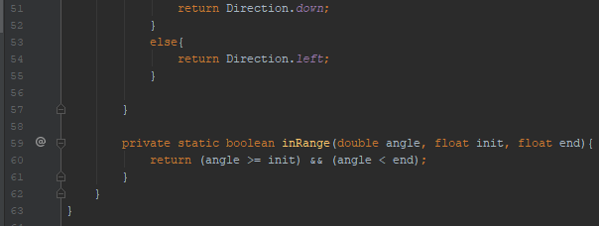
Custom View
3. Swipe–handling to move Theseus up

Slide 7
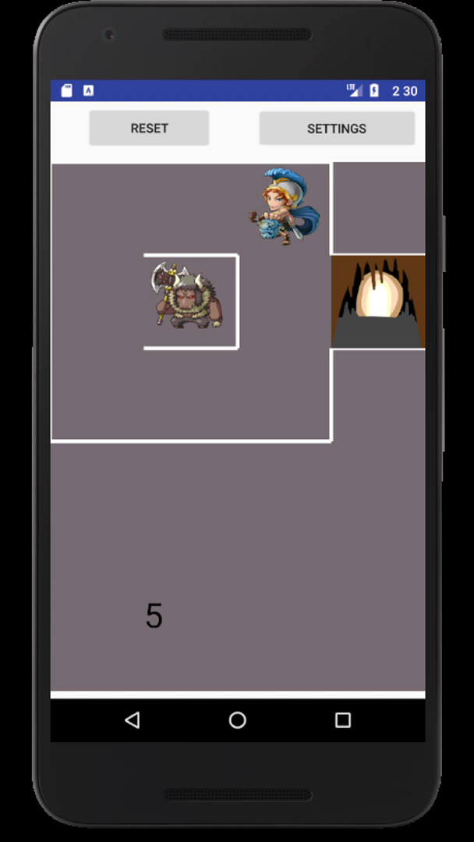
Custom View
4. Swipe–handling to move Theseus down

Slide 8

Custom View
5. Swipe–handling to move Theseus left

Slide 9
Custom View
6. Swipe–handling to move Theseus right

Slide 10
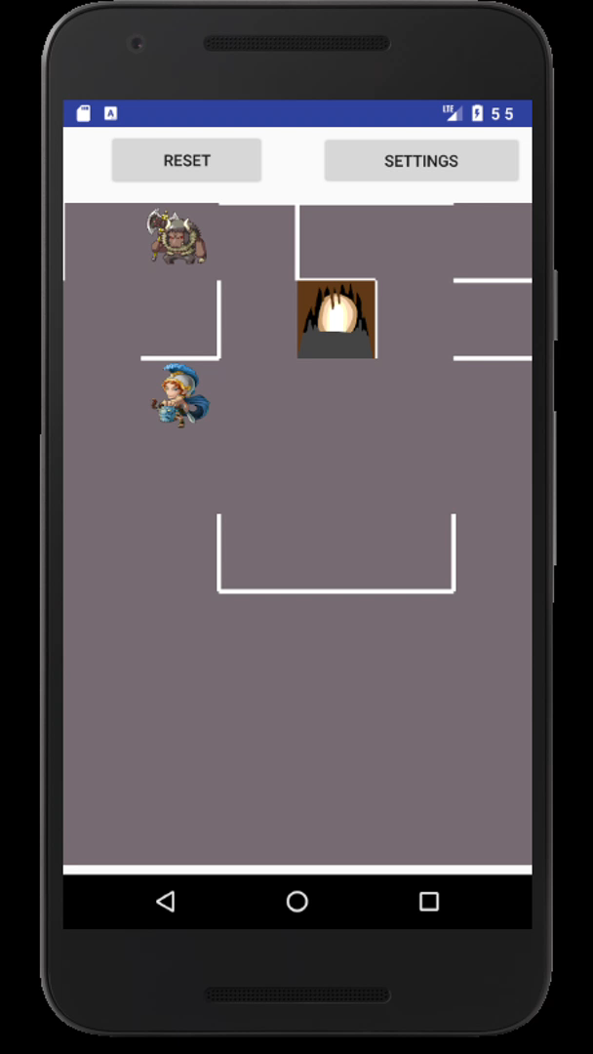
Custom View
7. Double-tap to pause

Slide 11
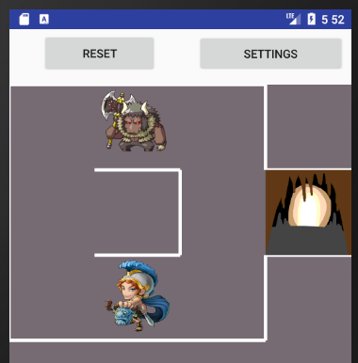
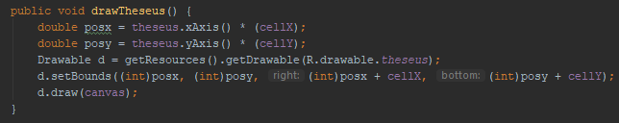
Custom View
8. Display image as Theseus

Slide 12
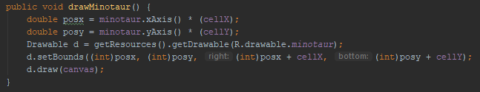
Custom View
9. Display image as Minotaur

Slide 13
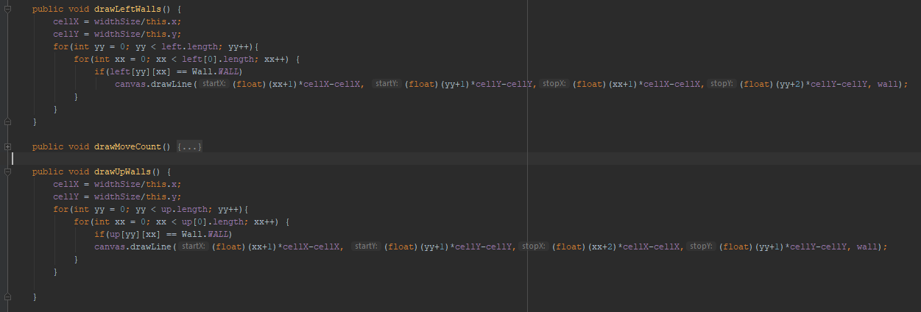
Custom View
10. Draw a maze

Slide 14
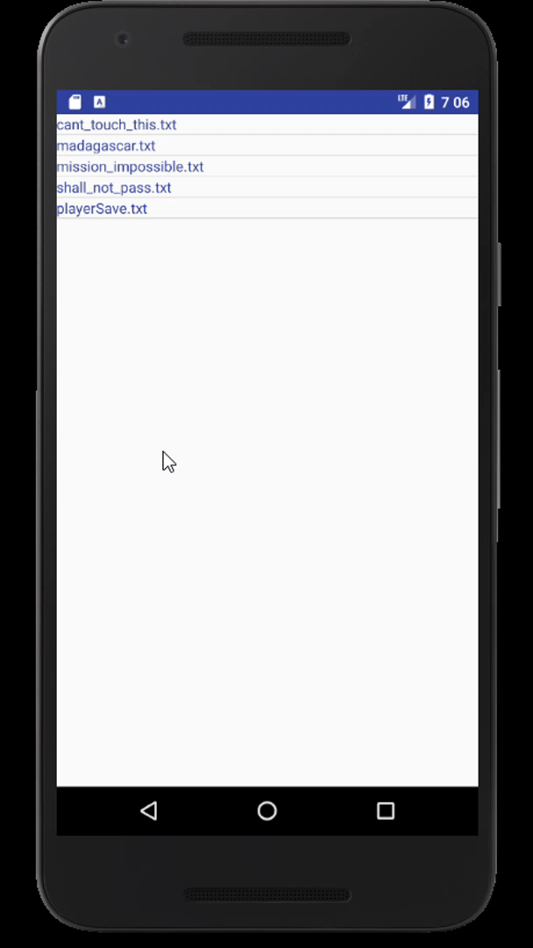
Custom View
11. Auto-generating a maze based on level data

Slide 15
Custom View
12. Display a maze

Slide 16
Custom View
13. Draw the walls

Slide 17
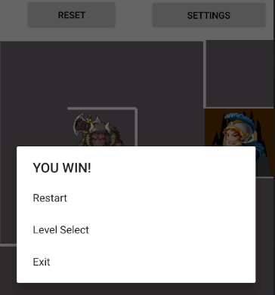
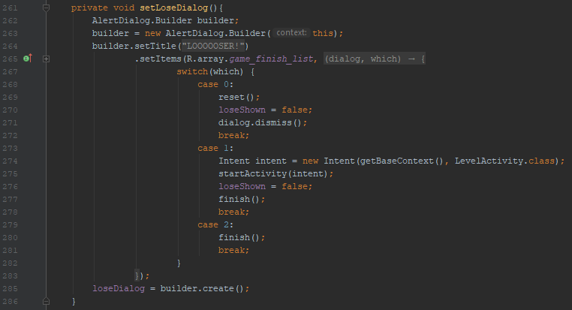
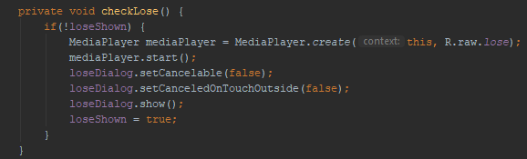
Custom View
14. Dialogue if Minotaur kills Theseus

Slide 18
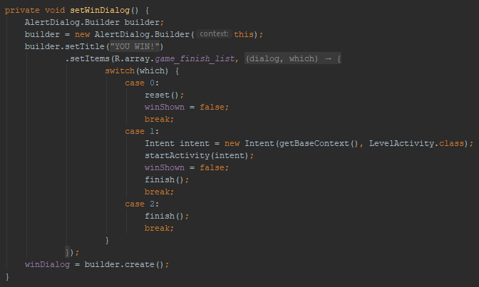
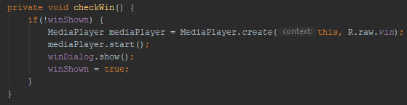
Custom View
15. Dialogue if Theseus wins/escapes

Slide 19
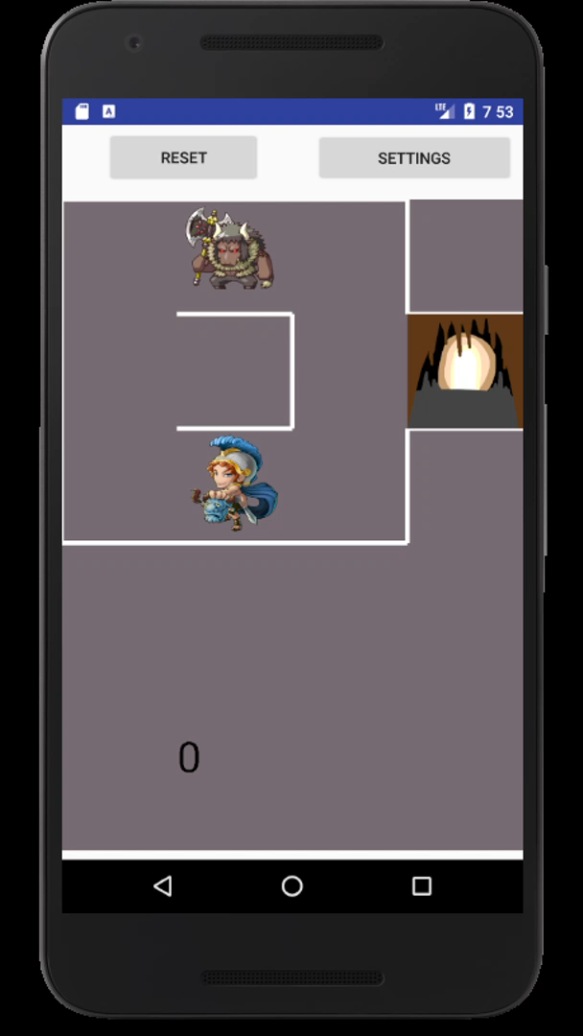
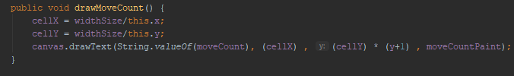
Custom View
16. Display move count

Slide 20
Custom View
17. Display dialogue with options after Theseus is killed

Slide 21
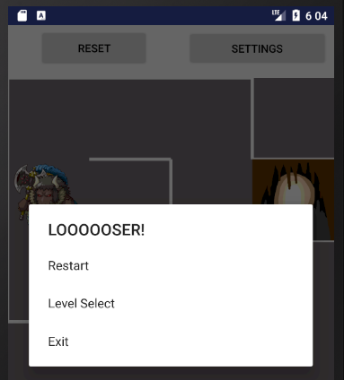
Custom View
18. Display dialogue with options after Theseus exits successfully

Slide 22
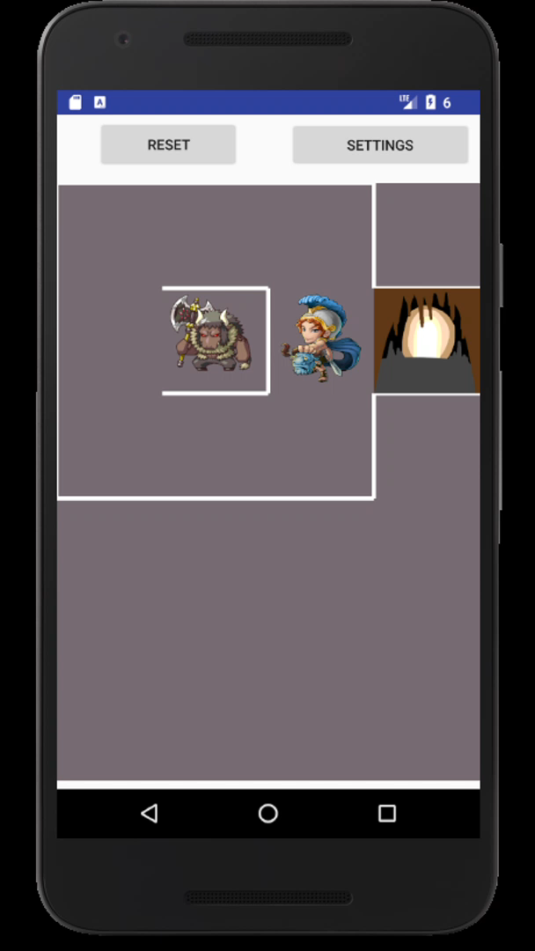
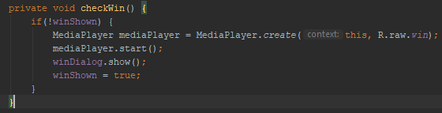
Custom View
19. Play a happy noise after Theseus exist successfully

Slide 23
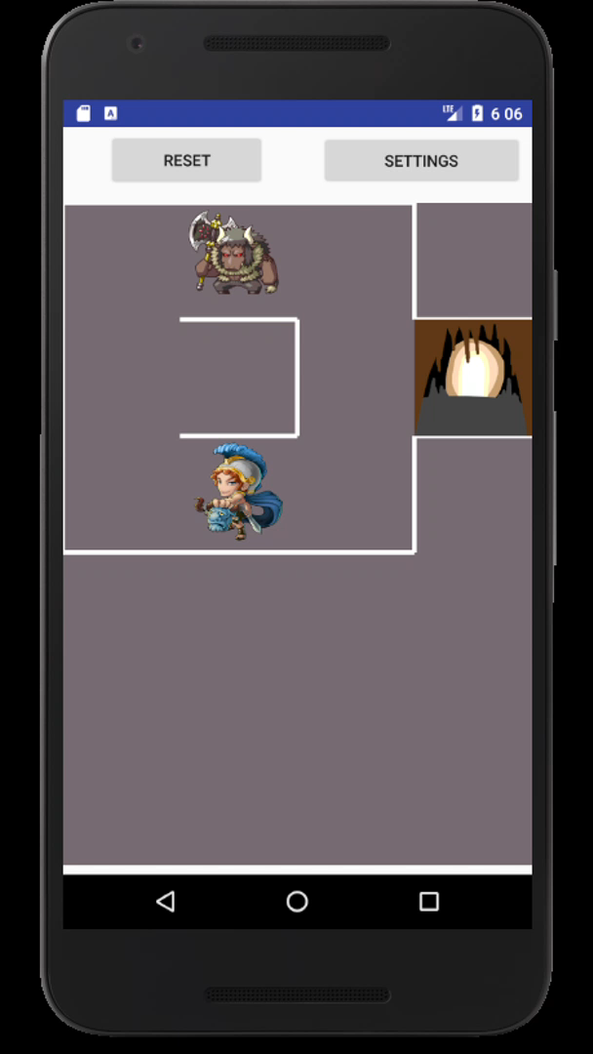
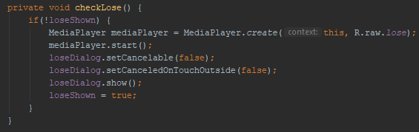
Custom View
20. Play a sad noise after Theseus has been killed

Slide 24
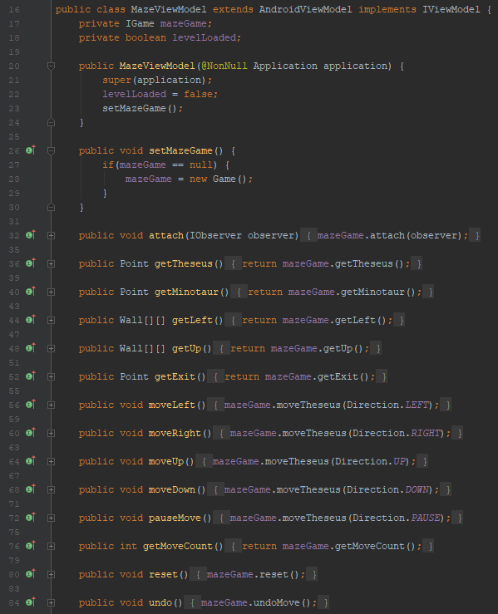
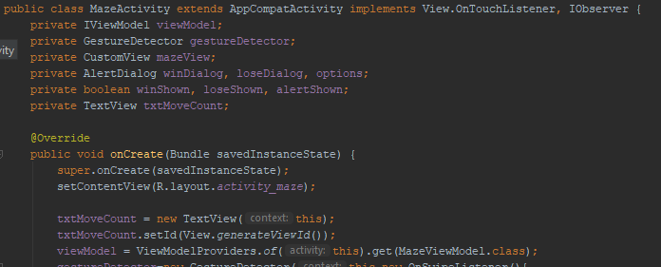
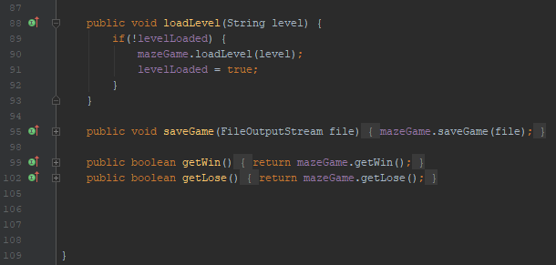
Custom View - Controller

Slide 25
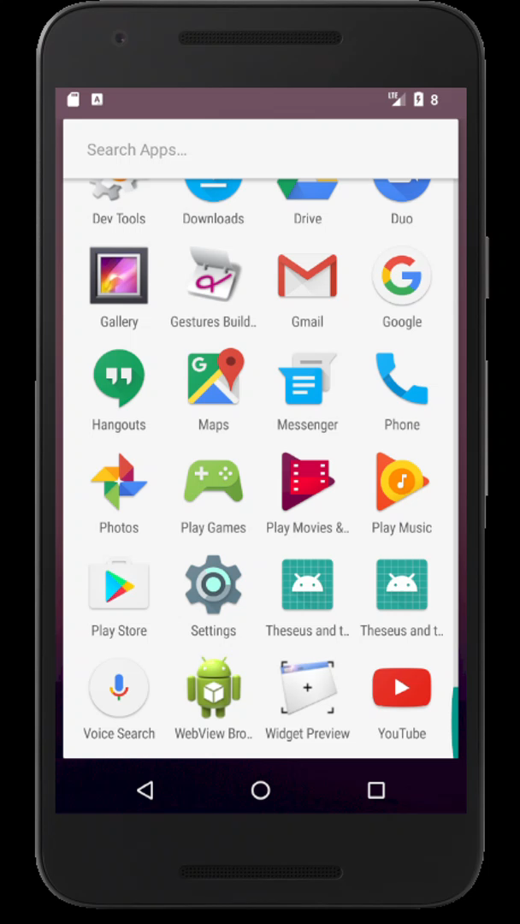
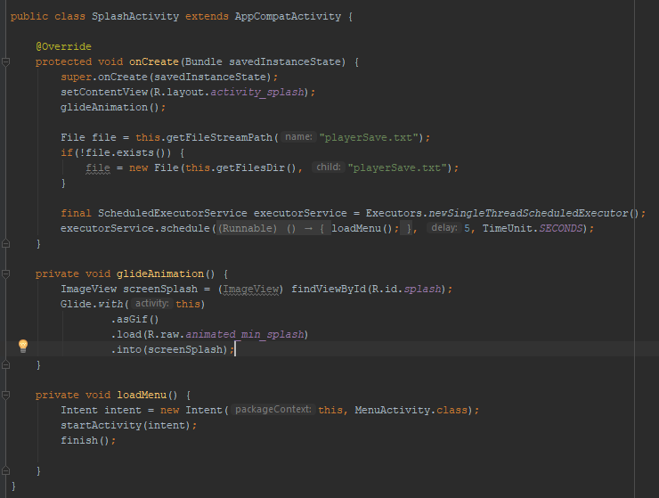
Custom View – Could Feature
1. Splash Screen – play gif

Slide 26

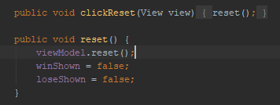
Custom View – Could Feature
2. Reset button

Slide 27
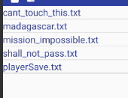
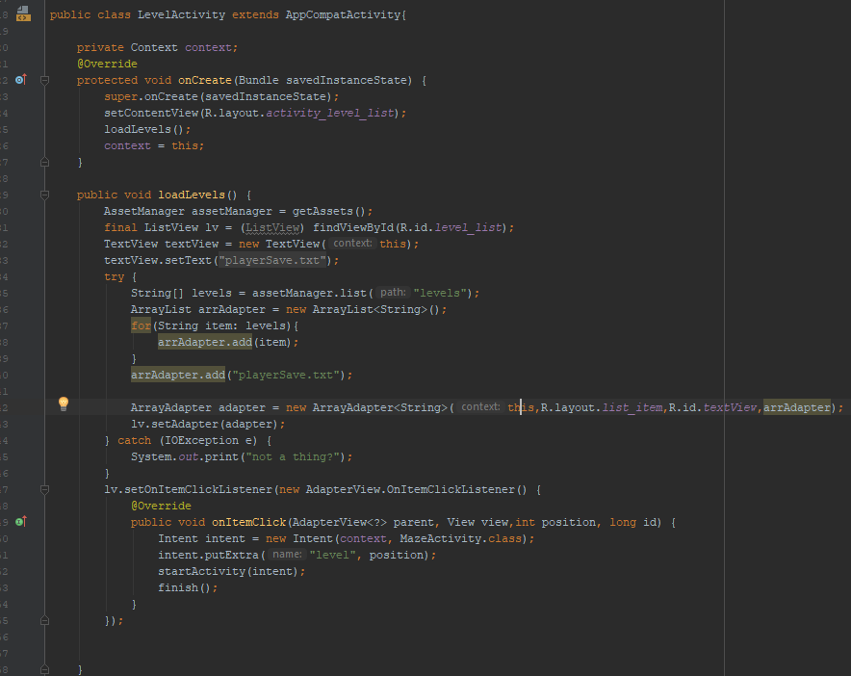
Custom View – Could Feature
3. Load menu

Slide 28
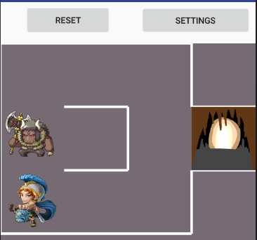
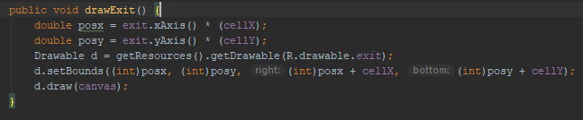
Custom View – Could Feature
4. Exit image

Slide 29
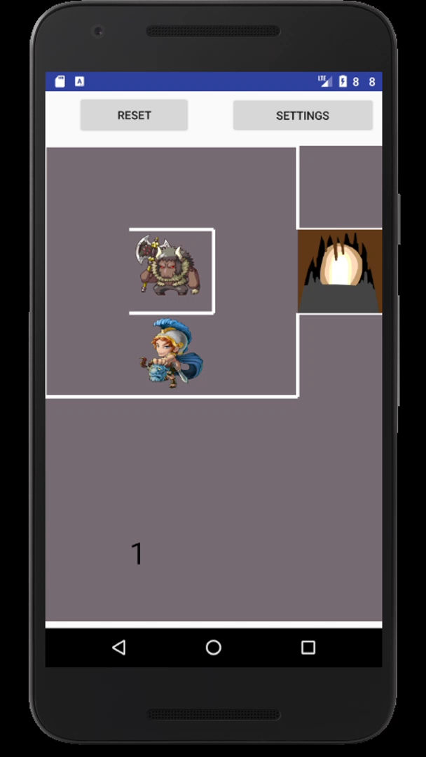
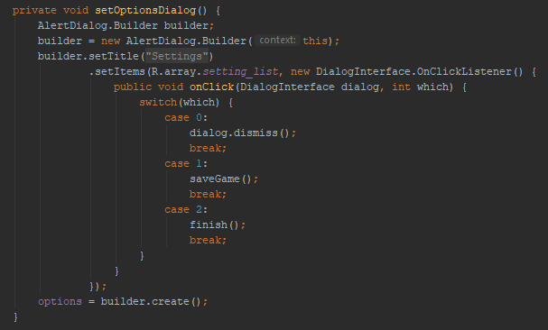
Custom View – Could Feature
5. Exit button

Slide 30
Dynamic View
Dynamic View was set up completely using java code. The layout file that was used only contained the default constraint layout and each view was added within the allocated java file

Slide 31
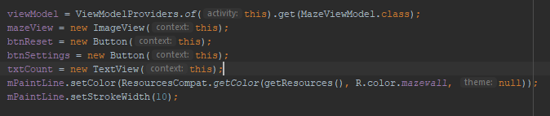
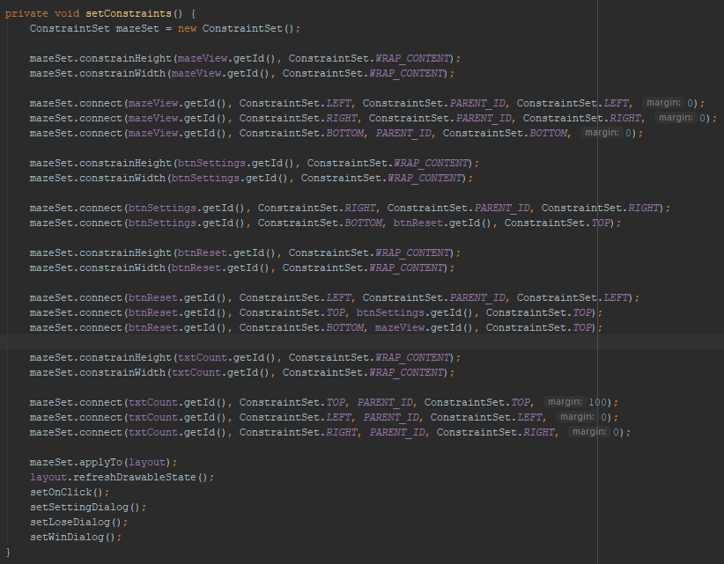
Dynamic View – Code example

Slide 32
Dynamic View
1. Button for loading a level

Slide 33
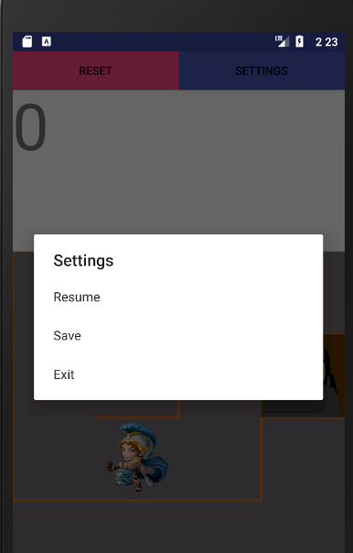
Dynamic View
2. Button for saving a level

Slide 34
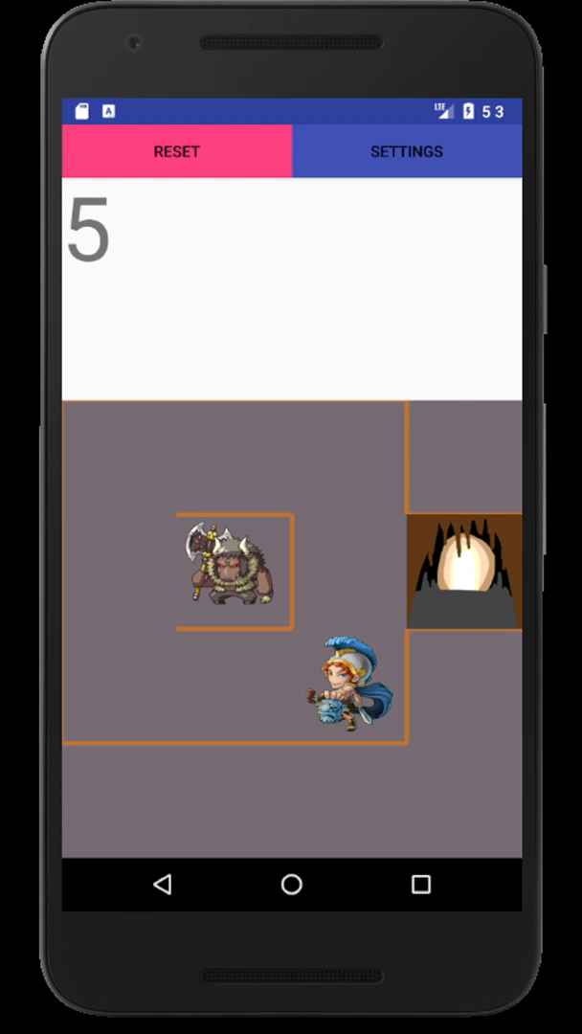
Dynamic View
3. Swipe–handling to move Theseus up

Slide 35

Dynamic View
4. Swipe–handling to move Theseus down

Slide 36
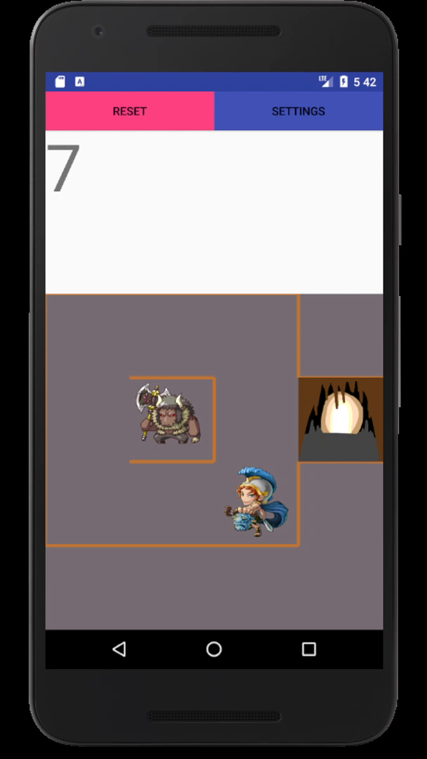
Custom View
5. Swipe–handling to move Theseus left

Slide 37

Dynamic View
6. Swipe–handling to move Theseus right

Slide 38
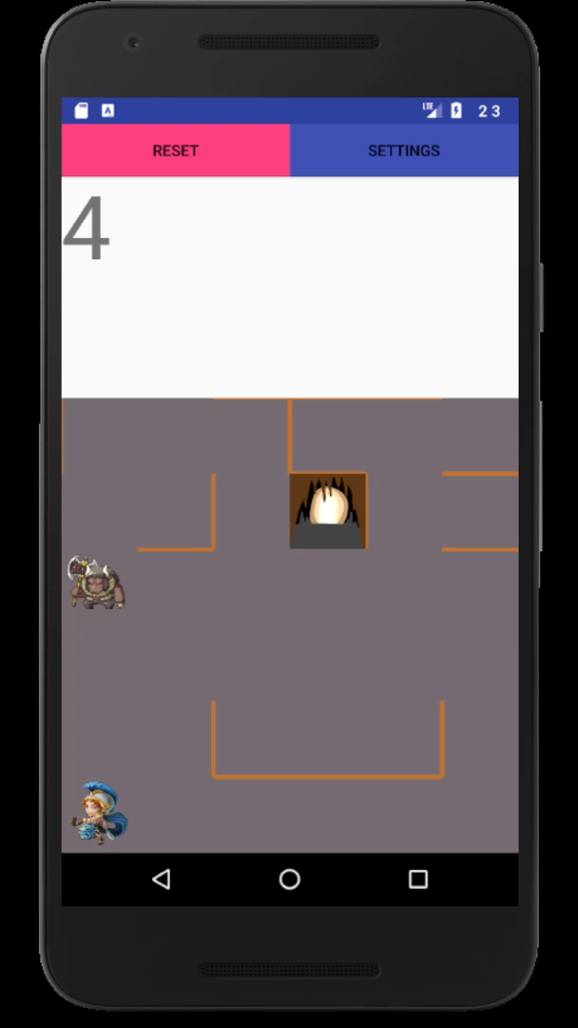
Dynamic View
7. Double-tap to pause

Slide 39
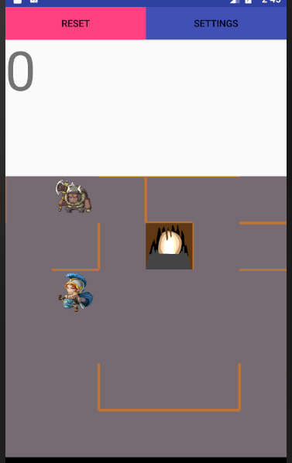
Dynamic View
8. Display image as Theseus

Slide 40
Dynamic View
9. Display image as Minotaur

Slide 41
Dynamic View
10. Draw a maze

Slide 42
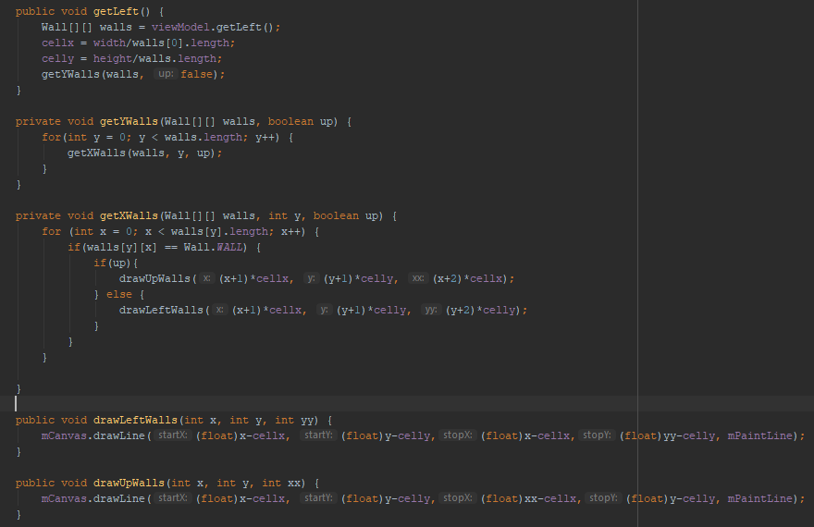
Dynamic View
11. Auto-generating a maze based on level data

Slide 43
Dynamic View
12. Display a maze

Slide 44
Dynamic View
13. Draw the walls

Slide 45

Dynamic View
14. Dialogue if Minotaur kills Theseus

Slide 46

Dynamic View
15. Dialogue if Theseus wins/escapes

Slide 47
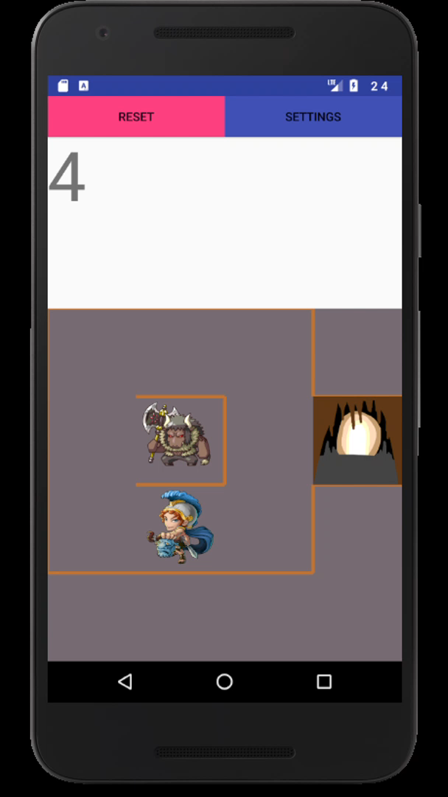

Dynamic View
16. Display move count

Slide 48

Dynamic View
17. Display dialogue with options after Theseus is killed

Slide 49

Dynamic View
18. Display dialogue with options after Theseus exits successfully

Slide 50
Dynamic View
19. Play a happy noise after Theseus exist successfully

Slide 51
Dynamic View
20. Play a sad noise after Theseus has been killed

Slide 52
Dynamic View - Controller

Slide 53
Dynamic View – Could Feature
1. Splash Screen – play gif

Slide 54
Dynamic View – Could Feature
2. Reset button

Slide 55
Dynamic View – Could Feature
3. Load menu

Slide 56

Dynamic View – Could Feature
4. Exit image

Slide 57

Dynamic View – Could Feature
5. Exit button

Slide 58


Dynamic View – Could Feature
6. Changing view orientation
Maintain state

Slide 59

Dynamic View – Could Feature
6. Changing view orientation
Using the built in ViewModel method, I was able to maintain game state from vertical to horizontal

Slide 60


Grahams Model
I created an adapter so that I could use Grahams model. Had to change the load functionality to load files

Slide 61

Knowledge Point 1 - UML
A UML design is used to understand the relationships between each object. This can be used as a way to communicate the design of a system without the other person having to even know the language

Slide 62


Provide all appropriate systems level documentation UML
Figure 1 shows the piece of code that relates to the figure 2 UML. It shows the properties and functions contained within an enumerator
Figure 2
Figure 1

Slide 63




Provide all appropriate systems level documentation UML
The below images show an interface. The below images denote an interface and the methods that must be used when it is inherited. Understanding the interface methods and the naming convention allows a developer to understand how each object communicates.

Slide 64

Provide all appropriate systems level documentation UML
As you would have to read the code to understand the relationship, a UML diagram will simplify the process. Seeing the relationship from the interfaces to the Game object communicates that the Game object is the Subject within the observer design. It also shows the list of methods that are usable from the Game object when the type is of IGame.

Slide 65
Code programs in the specified language using the prescribed standards
4.5.2 Indent continuation lines at least +4 spaces
When line-wrapping, each line after the first (each continuation line) is indented at least +4 from the original line.
When there are multiple continuation lines, indentation may be varied beyond +4 as desired. In general, two continuation lines use the same indentation level if and only if they begin with syntactically parallel elements.
Section 4.6.3 on Horizontal alignment addresses the discouraged practice of using a variable number of spaces to align certain tokens with previous lines.
https://google.github.io/styleguide/javaguide.html

Slide 66

Code programs in the specified language using the prescribed standards
4.5.2 Indent continuation lines at least +4 spaces

Slide 67
Code programs in the specified language using the prescribed standards
4.6.1 Vertical Whitespace
A single blank line always appears:
Between consecutive members or initializers of a class: fields, constructors, methods, nested classes, static initializers, and instance initializers.
Exception: A blank line between two consecutive fields (having no other code between them) is optional. Such blank lines are used as needed to create logical groupings of fields.
Exception: Blank lines between enum constants are covered in Section 4.8.1.
As required by other sections of this document (such as Section 3, Source file structure, and Section 3.3, Import statements).
A single blank line may also appear anywhere it improves readability, for example between statements to organize the code into logical subsections. A blank line before the first member or initializer, or after the last member or initializer of the class, is neither encouraged nor discouraged.
Multiple consecutive blank lines are permitted, but never required (or encouraged).
https://google.github.io/styleguide/javaguide.html

Slide 68

Code programs in the specified language using the prescribed standards
4.6.1 Vertical Whitespace

Slide 69
Code programs in the specified language using the prescribed standards
5.2.3 Method names
Method names are written in lowerCamelCase.
Method names are typically verbs or verb phrases. For example, sendMessage or stop.
Underscores may appear in JUnit test method names to separate logical components of the name, with each component written in lowerCamelCase. One typical pattern is <methodUnderTest>_<state>, for example pop_emptyStack. There is no One Correct Way to name test methods.
https://google.github.io/styleguide/javaguide.html

Slide 70

Code programs in the specified language using the prescribed standards
5.2.3 Method names

